Slide 1
LASP Research Summary

Slide 2
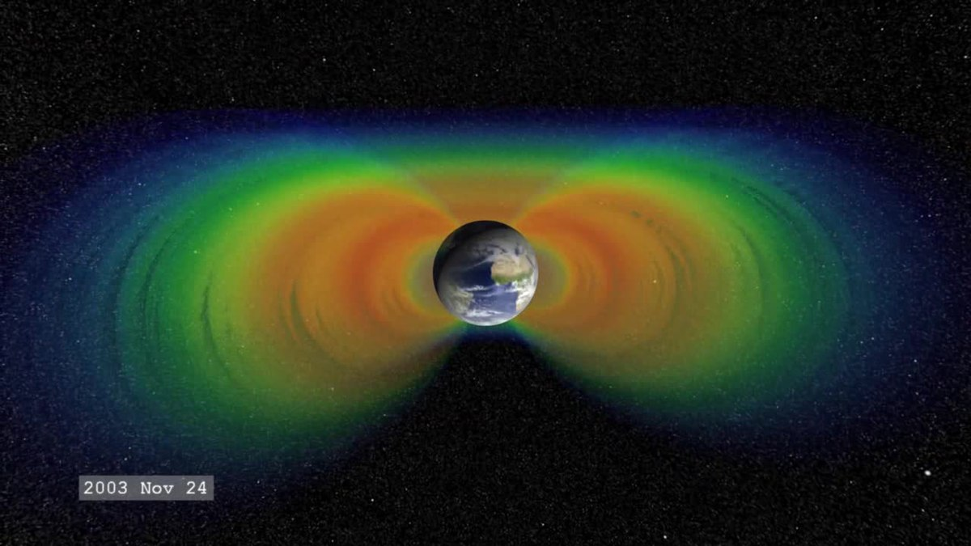
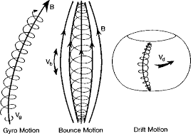
Science Background
The Earth’s radiation belts are composed of electrons interacting with the planetary magnetic field in 3 main motions:
Gyro motion
Bounce motion
Drift motion
Electrons with small velocity pitch angles relative to the local magnetic field lines will more likely precipitate into the Earth’s atmosphere before bouncing
Pitch angle anisotropy is defined by how electron population pitch angles are distributed:
Isotropic: Pitch angles are pointed everywhere equally
Anisotropic: Pitch angles are pointed unevenly
J. Sample, PhD Thesis (2013)
(From Yuting Ng, 2013)
(From Wikipedia)

Slide 3
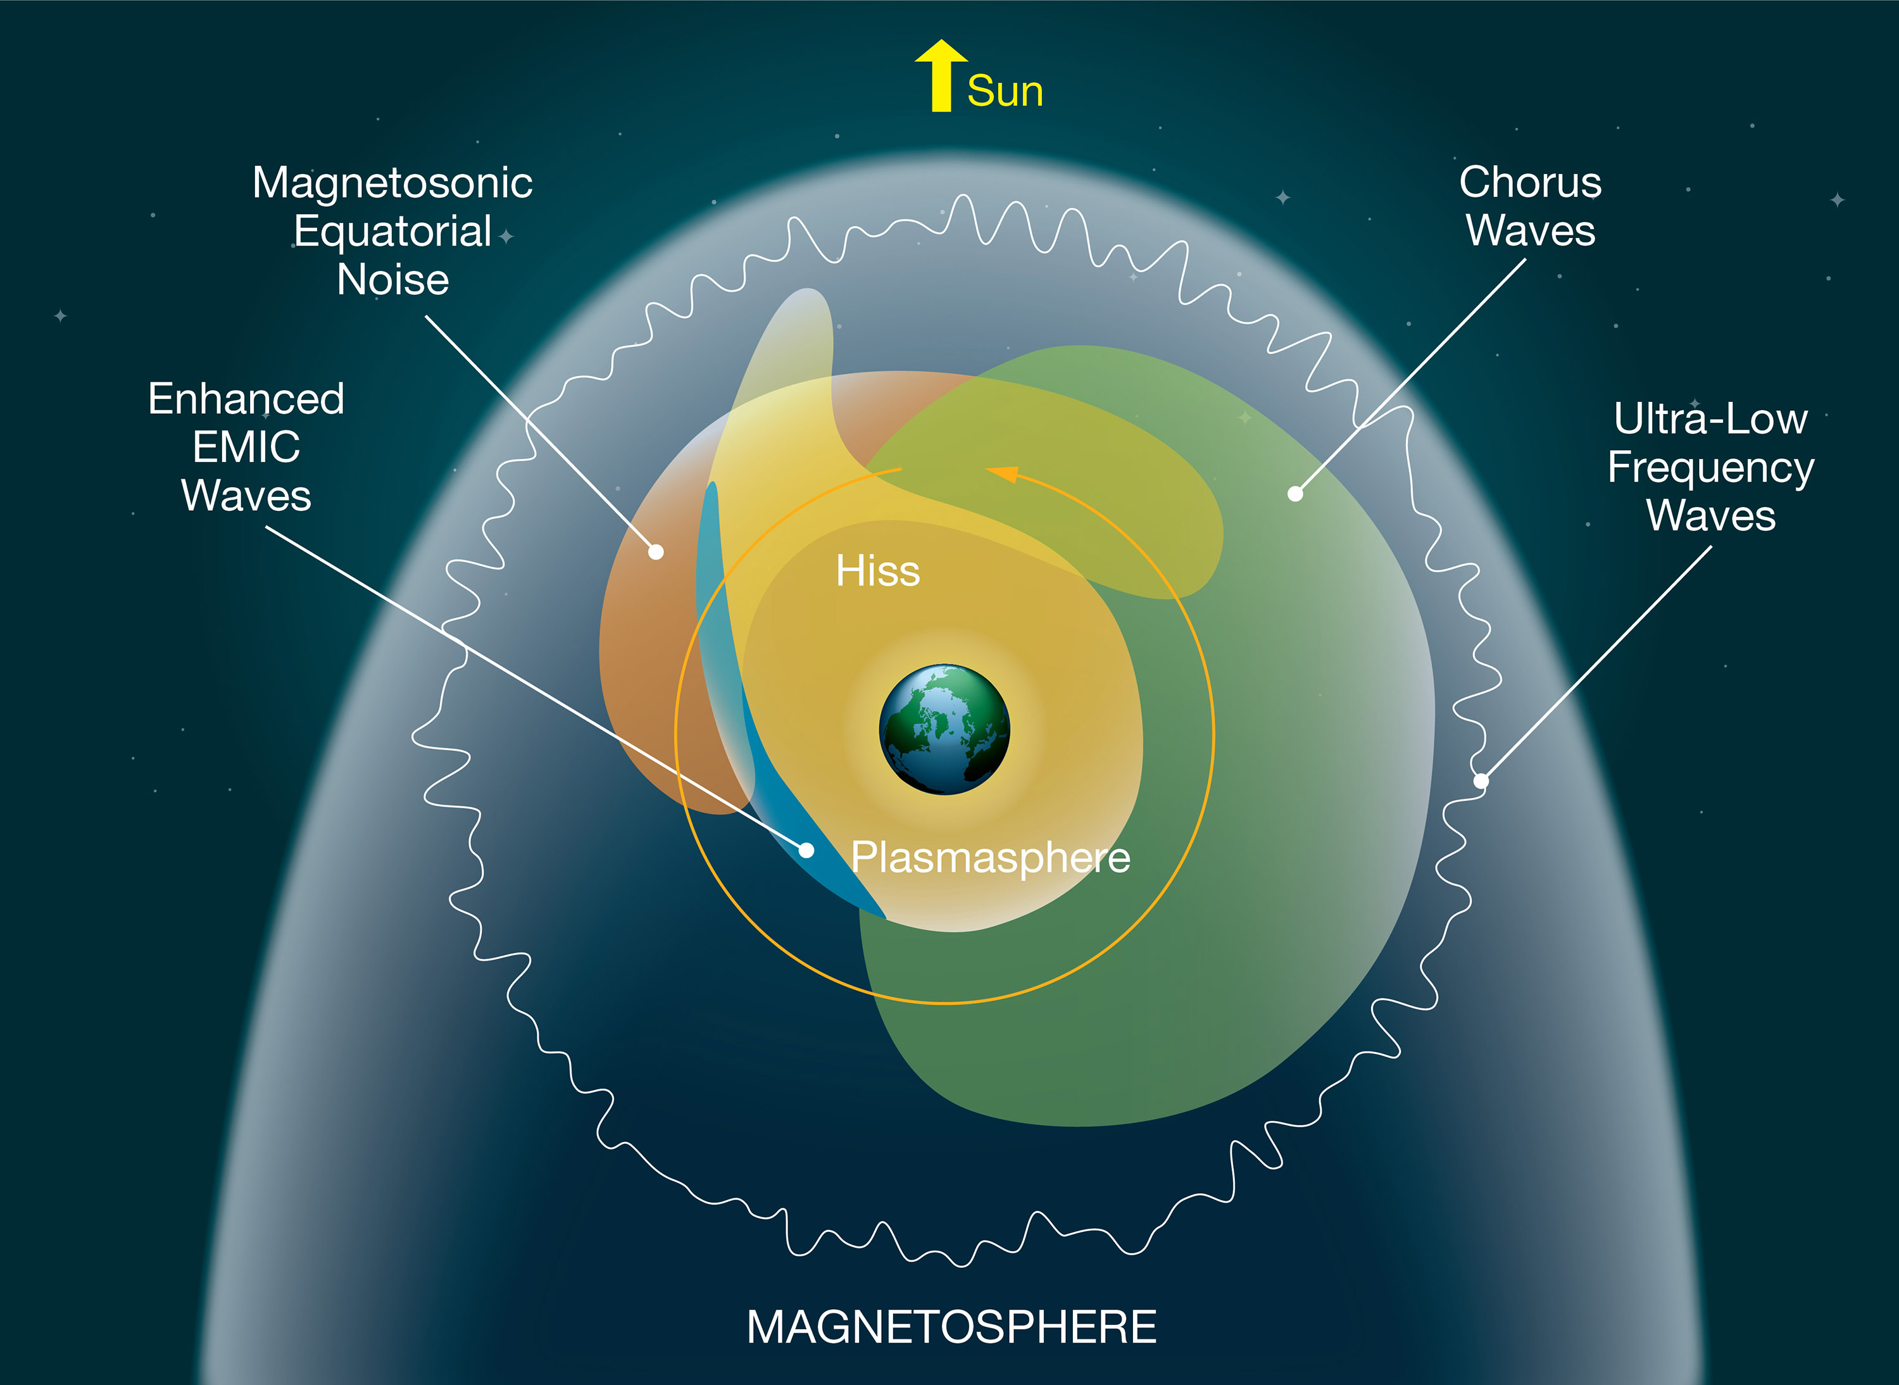
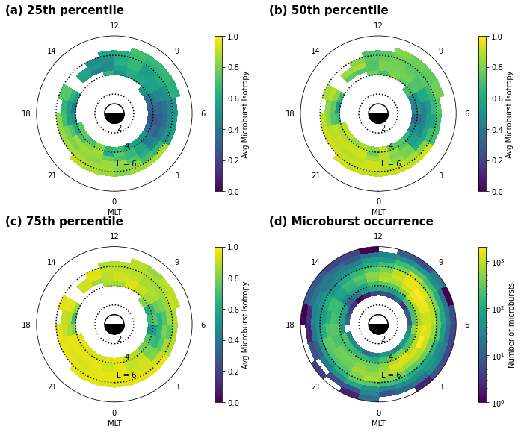
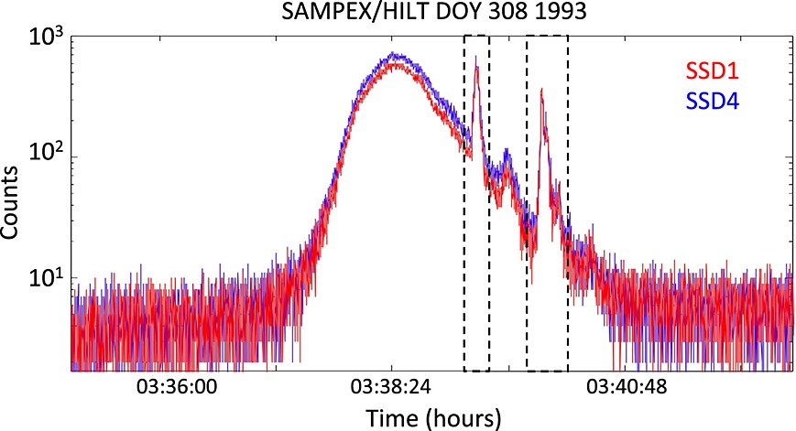
Science Background
(From NASA)
(From Blum et al, 2015)

Slide 4
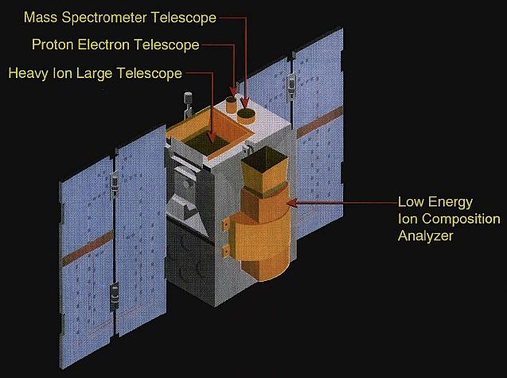
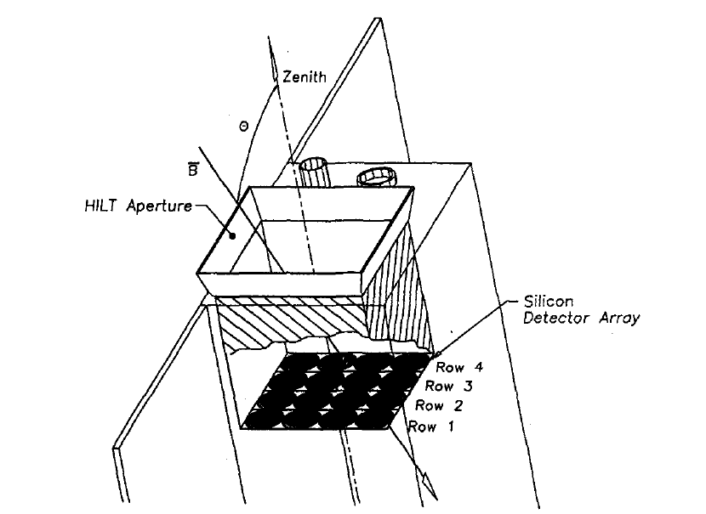
Mission Background
The Solar Anomalous and Magnetospheric Particle Explorer (SAMPEX) satellite collected information about particles in the Earth’s radiation belts in near polar orbit from 1992-2004
The Heavy Ion Large Telescope (HILT) instrument onboard the SAMPEX satellite consisted of 4x4 Silicon detector array that recorded >1 MeV electron counts in high latitude regions of the magnetosphere
(From eoPortal Directory)
When anisotropic populations of electrons are collected by the HILT instrument, the geometry of the detector rows will cause differences in the total electron counts detected across the array.
Conversely when isotropic populations of electrons are collected by the HILT instrument, the total electron counts detected will be similar across the array.
By taking the ratio of electron counts from Row 1 (SSD1) and Row 4 (SSD4) of the detectors, a measure of pitch angle isotropy can be determined, where:
Iso = 0 -> Anisotropic
Iso = 1 -> Isotropic
(From Blake et al, 1996)

Slide 5
Microburst Research Project
Statistic year study of microburst occurrence and pitch angle isotropy normalized against the background electron population
4 storm study observing microburst pitch angle isotropy storm-time variance normalized against the background electron population

Slide 6
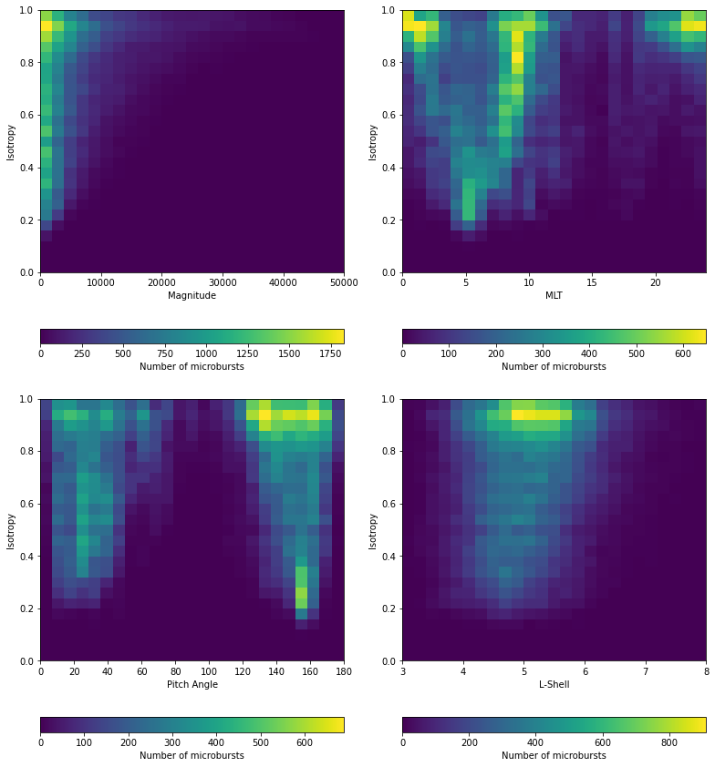
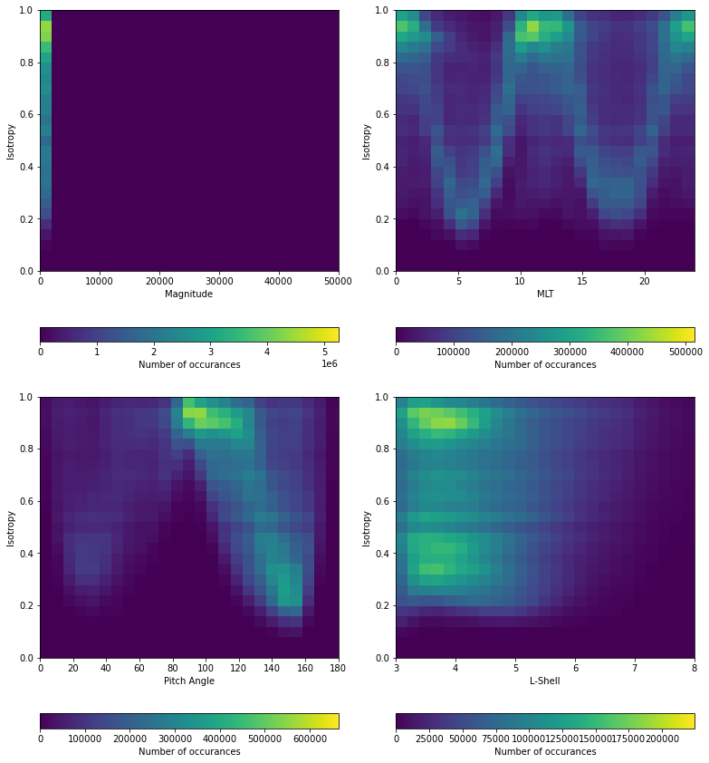
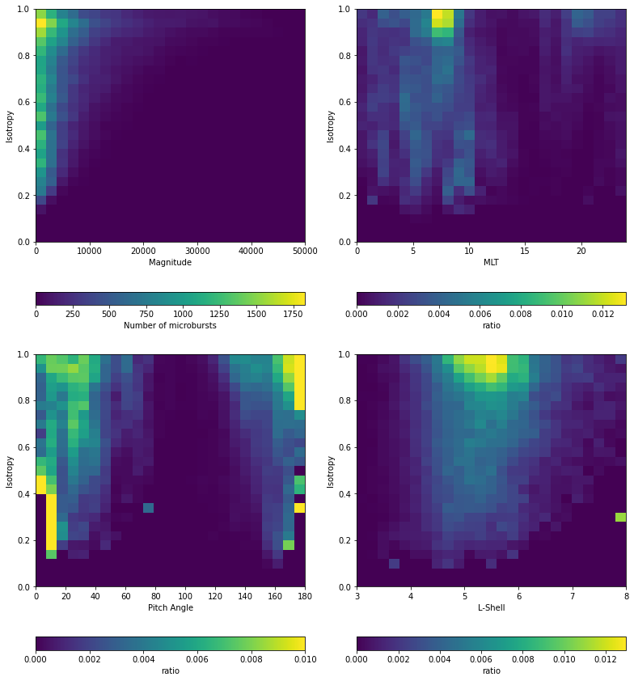
Microburst & Background Iso Correlations
1) Microburst 2) Background 3) Ratio

Slide 7
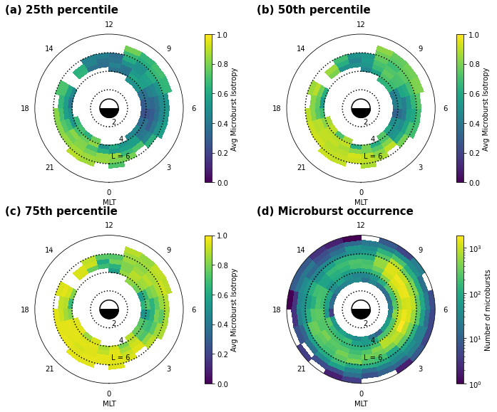
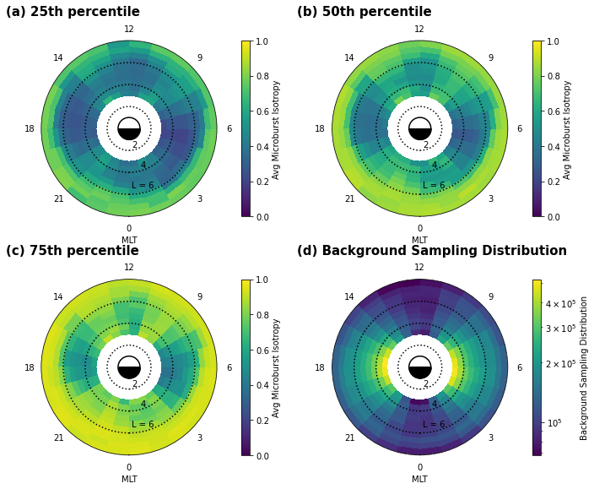
Microburst & Background Iso-MLT-L Plots
1) Microburst 2) Background

Slide 8
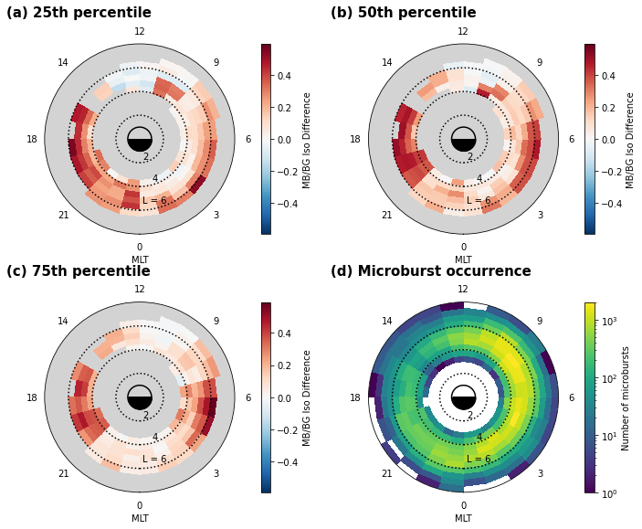
Microburst & Background Iso-MLT-L Plots (cont’d)
1) Difference

Slide 9
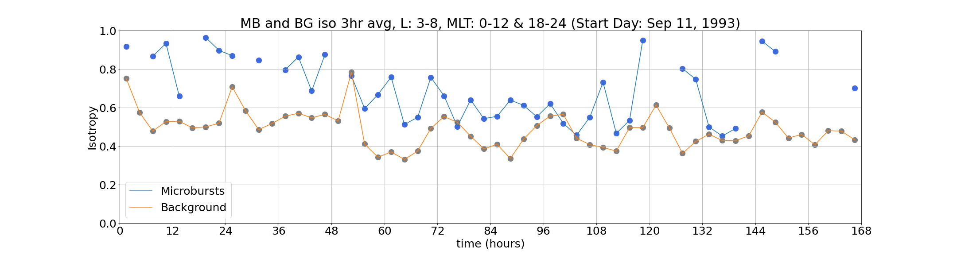
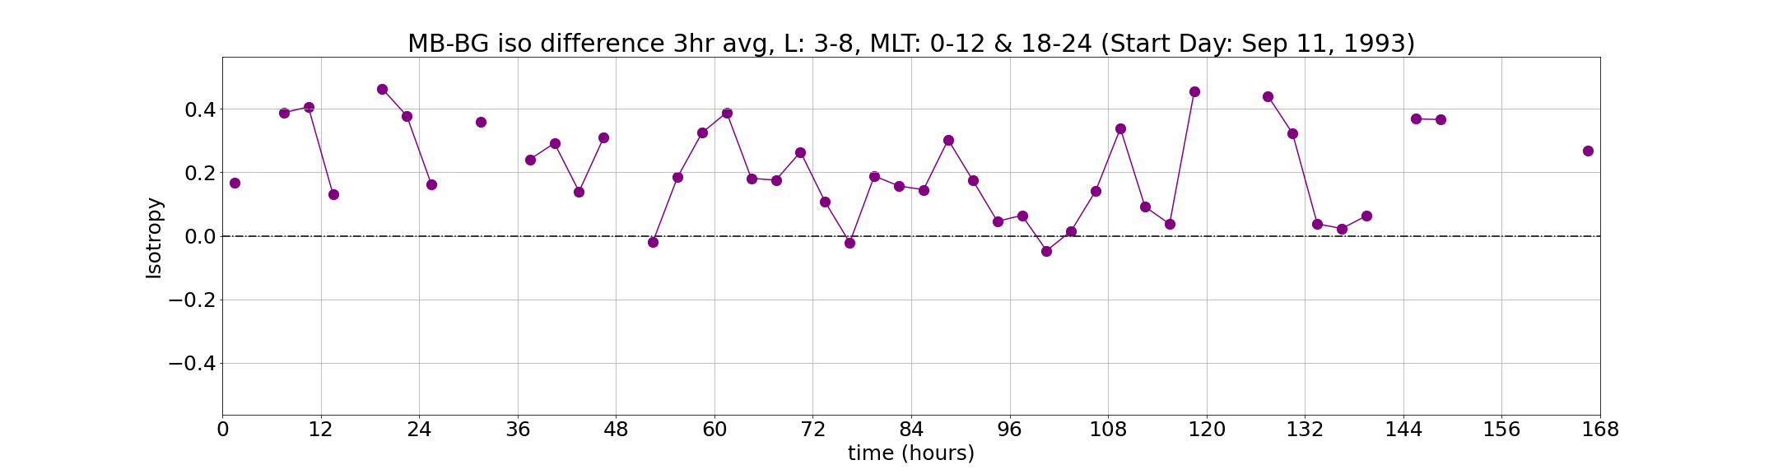
Microburst & Background Isotropy vs Time

Slide 10
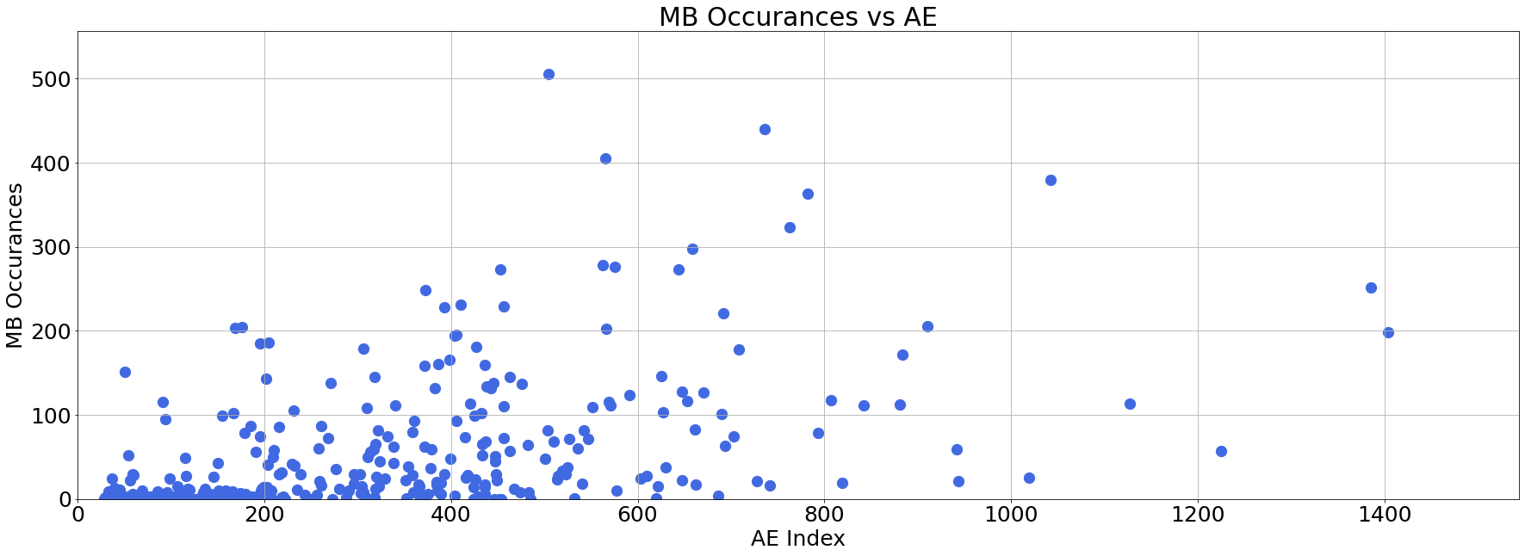
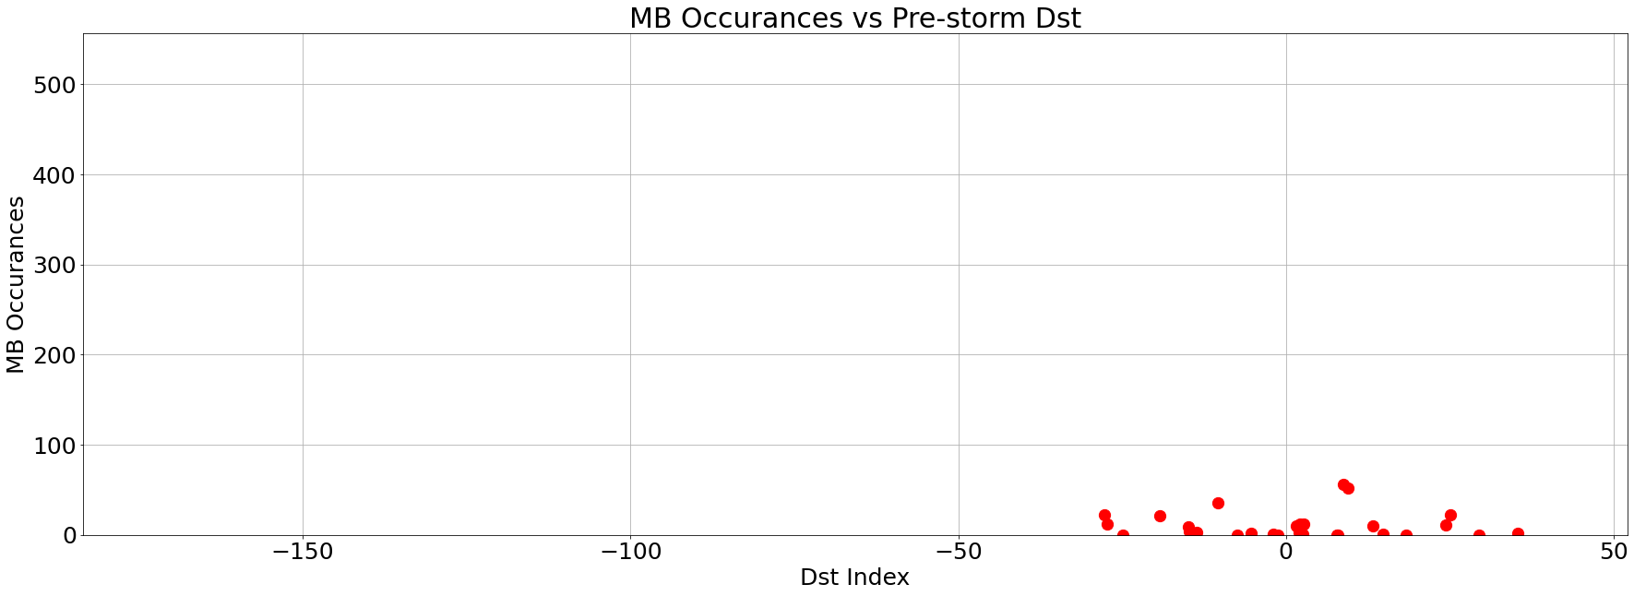
Microburst Occurrences vs Magnetic Indices

Slide 11
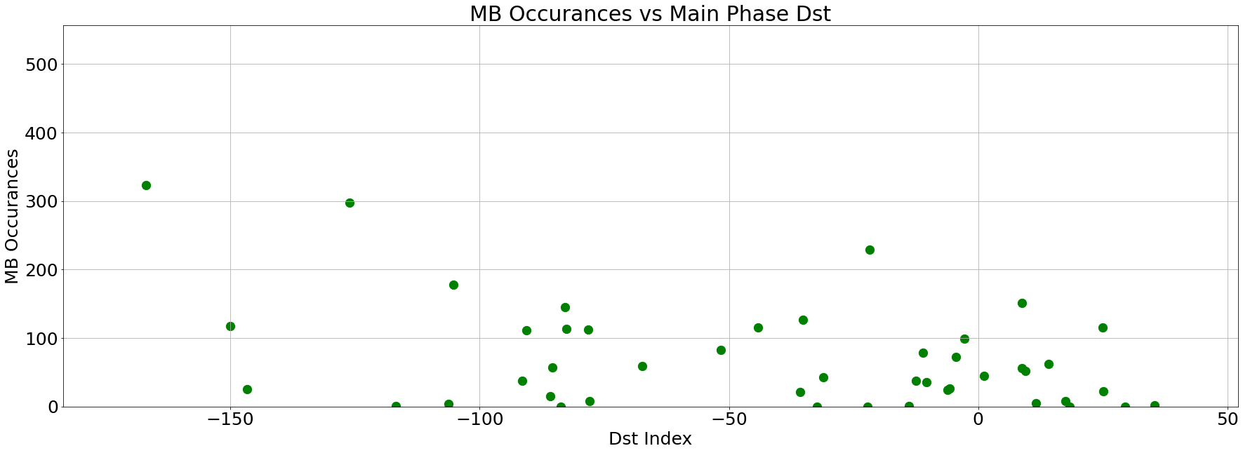
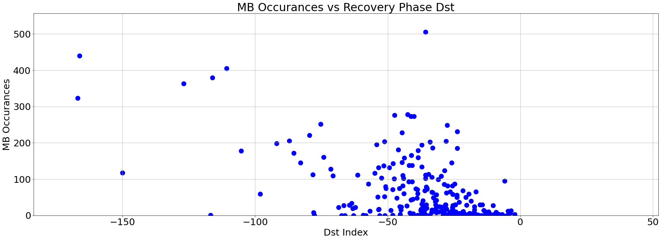
Microburst Occurrences vs Magnetic Indices (cont’d)

